Slide 1

House Price Prediction
Machine Learning Assignment
Team:-
Aishwarya
Supriya
Roona Shree

Slide 2
Objectives
Overview of data
Data understanding
Exploratory Data Analysis
Univariate Analysis
Hypothesis/questions formulation
Bivariate Analysis
Feature Engineering
Linear Regression Model Fitting
Decision Tree Regression Model Fitting
Final Model Testing
Adding new transformed variables
Dummy variables & one hot encoding
Forward Selection
Backward Selection
Performance Dashboard

Slide 3
Overview of DAta
Variables | Meaning
id | Unique identifier for the house
date | Date house was sold on
price | The sale price of the house
bedrooms | Number of bedrooms
bathrooms | Number of bathrooms
sqft_living | Square feet area of living room
sqft_lot | Square feet area of the lot
floors | Number of floors in house
waterfront | House with waterfront view or not (0 or 1)
view | Whether the house has been viewed
condition | How good is the condition of house
Variables | Meaning
grade | Grade given to the house
sqft_above | Square feet area apart from the basement
sqft_basement | Square feet area of the basefeet
yr_built | Year the house was built
yr_renovated | Year the house was renovated
zipcode | Zipcodes of the house area
lat | Latitude details
long | Longitude details

Slide 4
Hypothesis
Does the Grade have any impact on house price?
Does the house with waterfront are priced higher or is it the opp..?
Does older the house means lesser the cost?
The house with a high number of views cost less or cost more?
Is the renovation have to do anything with the house price?
What the hack is basement squarefeet?Does it have any impact on price..?

Slide 5
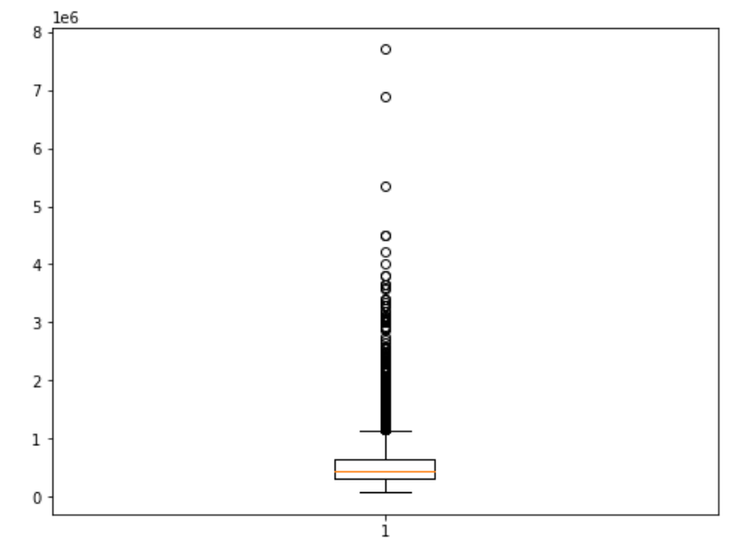
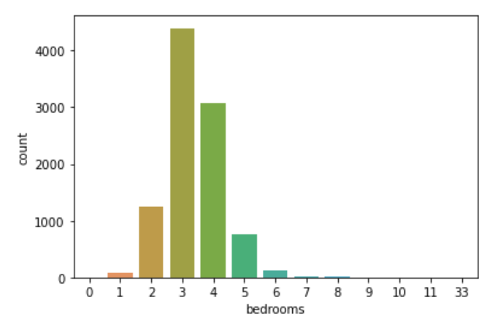
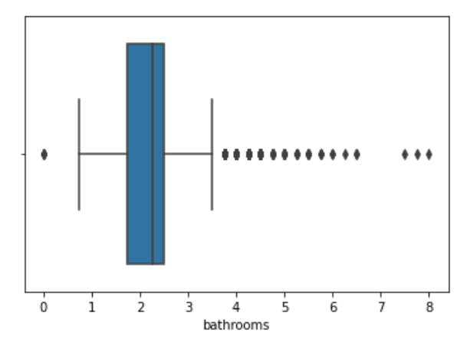
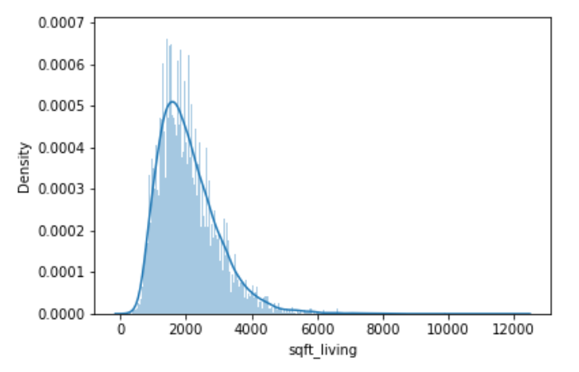
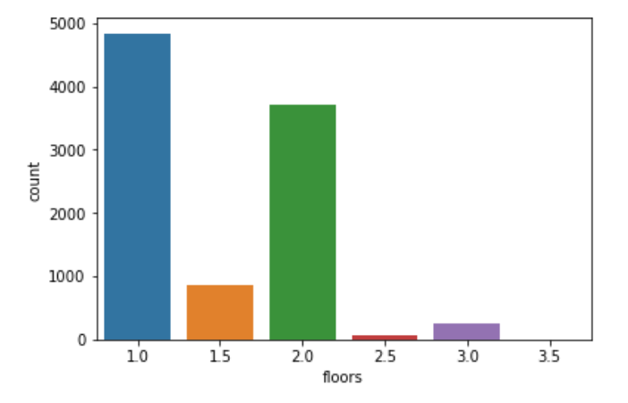
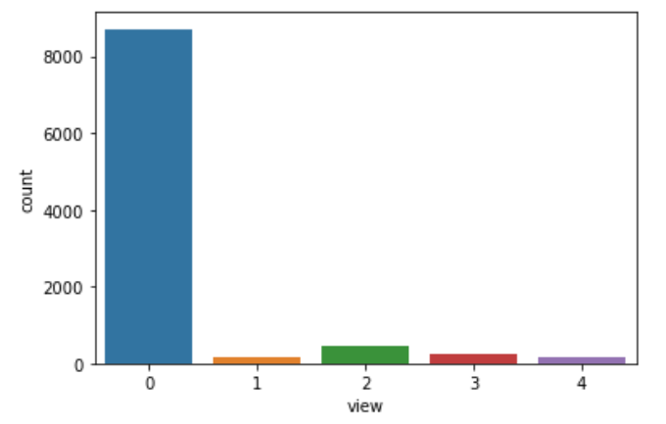
EDA
Univariate data analysis
Price

Slide 6

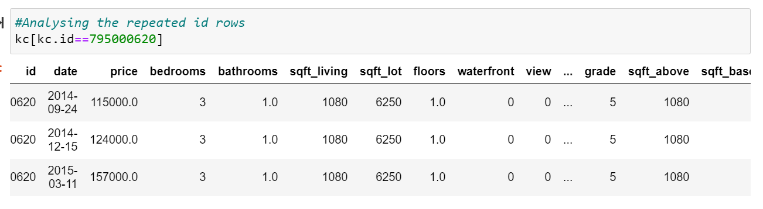
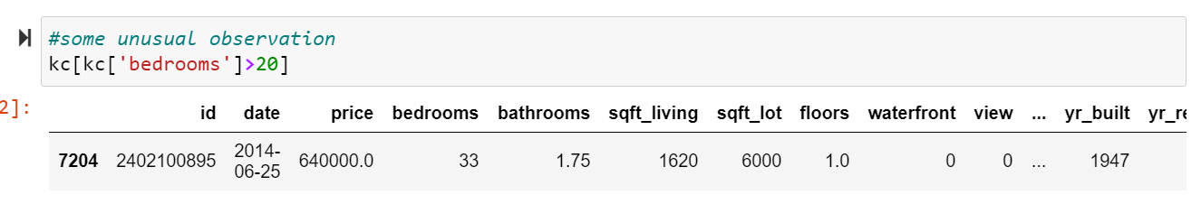
EDA
Some strange things noted..
While analyzing the column ID we noticed that some of the House Ids are duplicate but with different sale dates and prices and rest all attributes being same. This means the houses were resold.
‘There were total 40 duplicate ids’
When the number of bedrooms was more (like 33 in this case considered), the values under sqrt_living and sqrt_lot were very less than what it should have been. Logically , we can assume that that might be some error in data entry.

Slide 7
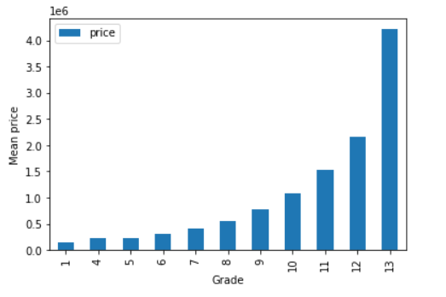
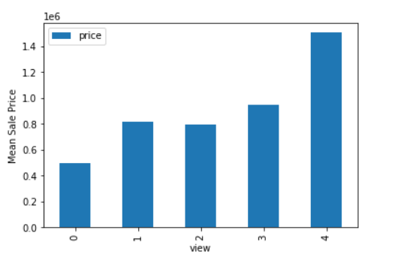
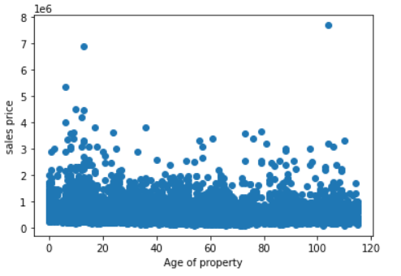
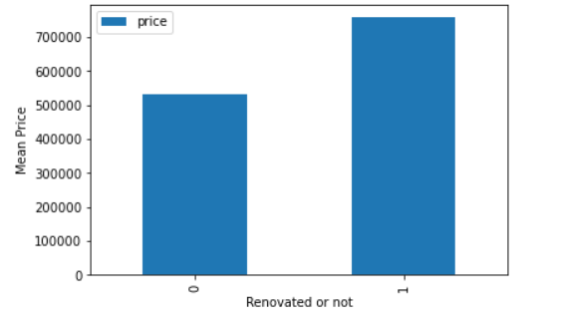
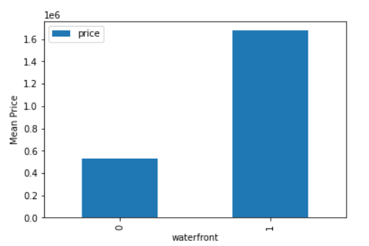
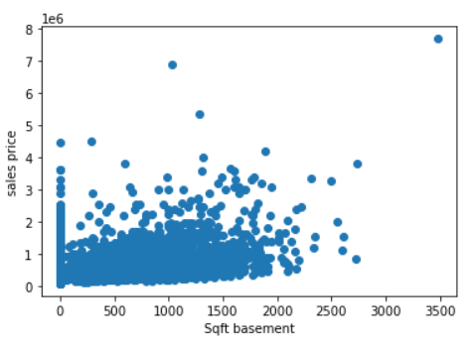
EDA
Data gave response to our initial hypothesis
Higher the grade, costlier the houset
Lower the prices, higher the chance the house get sold out quickly
Age of house don’t impact its cost
Want a better price of your house, get it renovated
People ready to pay more for natural beauty
Not a strong relation ship b/w house price and basement area

Slide 8
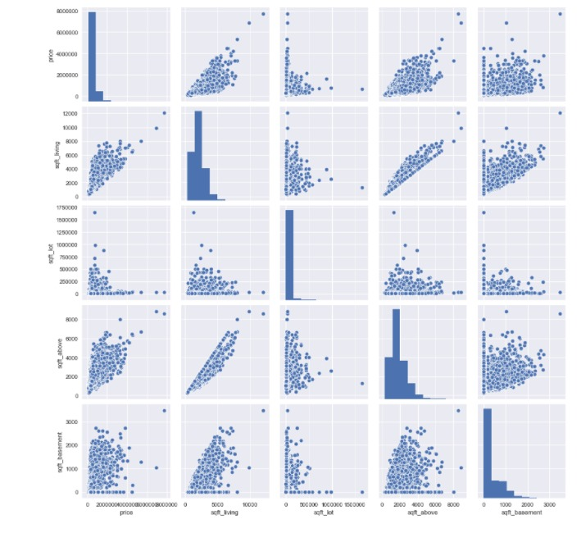

Scatter Matrix

Slide 9
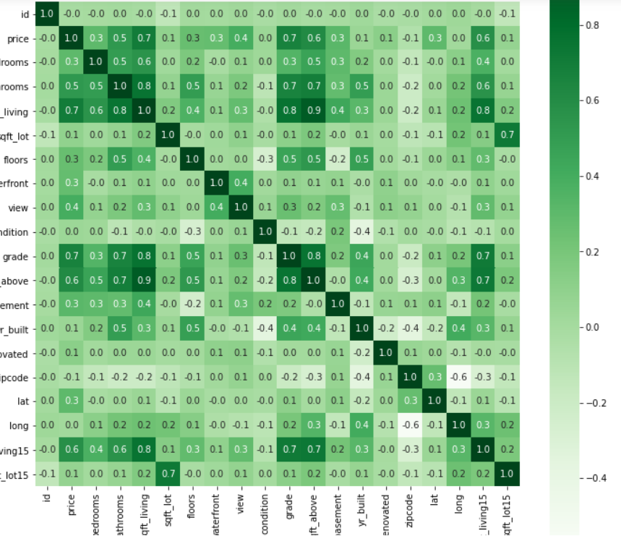
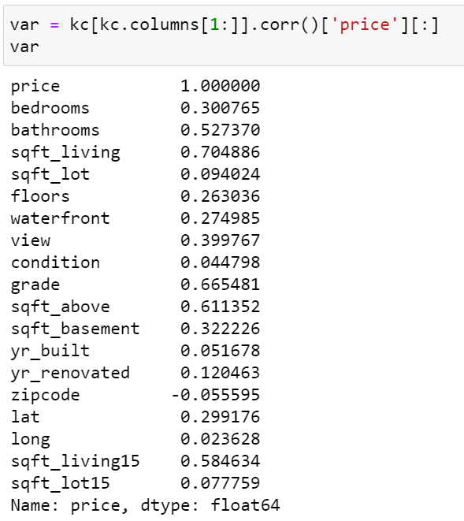
Correlation Matrix

Slide 10
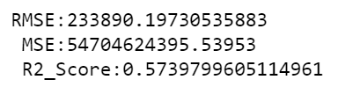
Linear Regression Model Fitting
As we can observe from the bivariate analysis , most of the variables are linearly correlated with each other , we have selected ‘Linear Regression’ for model fitting.
There are 2 methods through which we select features for the best model fitting:
1. Backward selection -
LinearReg(['sqft_living’,'floors','bathrooms','bedrooms','grade','waterfront','sqft_basement','view',’id’,’date’,’bedrooms’,’bathrooms’,’sqft_lot’,’floors’,’condition’,’sqft_above’,’yr_built’,’yr_renovated’,’zipcode’,’lat’,’long’])

Slide 11
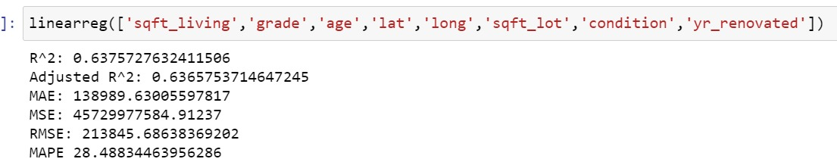
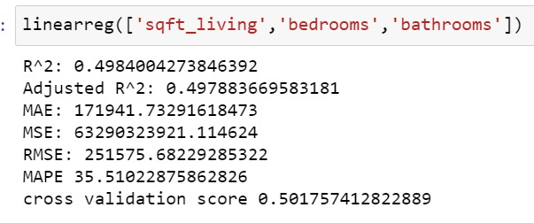
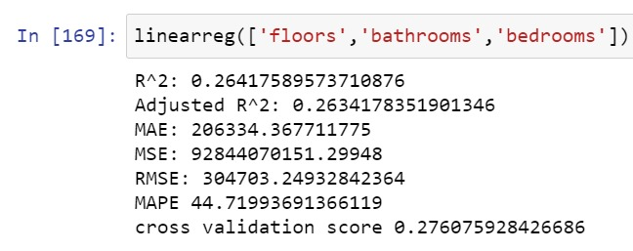
Forward selection -
63.75%
49.84%
26.41%

Slide 12

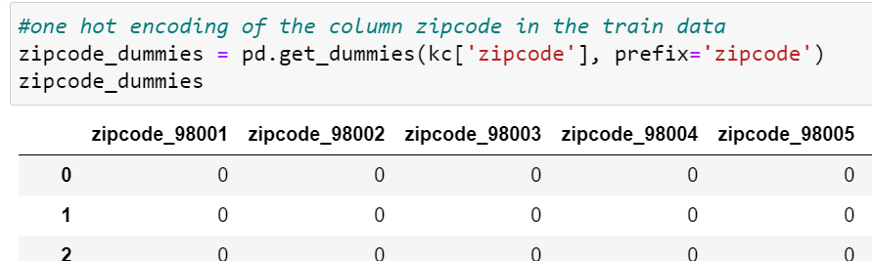
Feature Engineering
Creating new features from existing features
Zipcode column
One hot encoded Zipcode
1.
Age = Year built – Year sold
2.

Slide 13
New column checking if basement present (value 1) or not present (value 0)
3.
New column checking if house renovated (value 1) or not renovated(value 0)
4.

Slide 14
model performance
S.No | Feature Set |  | Justification | Peformance
 | Original features | Transformed features |  | R2 | RMSE | MAPE | 10 Fold CV
1 | sqft_living,bedrooms,bathrooms | None | Variables with highest correlation with price | 0.50 | 251575.68 | 35.51 | 0.50
2 | sqft_living, grade, waterfront | None | Varaibles which are not highly correlated with each other and have high correalation with price | 0.58 | 230687.95 | 34.13 | 0.57
3 | sqft_living, grade, lat, long , sqft_lot, condition, yr_renovated | age | Variables that are independent with each other but realted with price | 0.64 | 213845.69 | 28.49 | 0.64
4 | sqft_living, waterfront, view, grade, sq_ft living | basement_present, rennovated, one hot encoded zipcode,Square of sqft living | Added the flag for renvation, basement and included zipcode with one hot encoding | 0.82 | 151465.12 | 18.07 | 0.78
Observation on model performance on feature transformation
Log of sqft_living – reduced the Rsquare score
Square of all predictors – increased the Rsquare score on train data but it overfitted the model and gave very poor performance on the test data.
Square of sqft_living – increased the Rsquare Score
Sqrt of sqft_living – reduced the Rsquare score

Slide 15
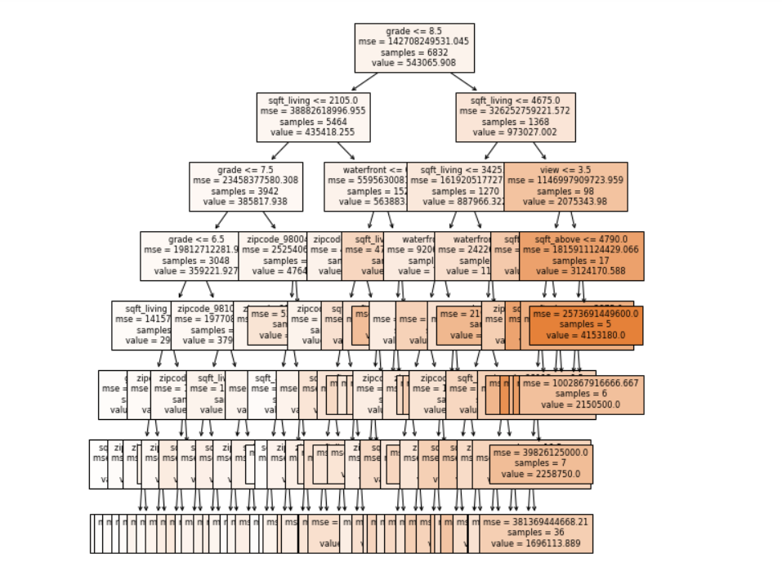
Decision Trees
Key Observation
Performance score is lesser than Linear regression with the same feature set
By hypertuning the parameter of max depth using Random Search the Score increases as we and after 7 score started declining
We picked the max-depth as 7

Slide 16


Final Model Testing with
sqft_living
Waterfront
view, grade
basement_present
renovated
one hot encoded zipcode
R2_Score: 0.8188
RMSE: 152556.48
https://github.com/Supriya92-github/KING_COUNTY-HOUSE-PRICE-PREDICTION/settings/notifications
https://github.com/Aishwarya206/KC-House-sales-Prediction

Slide 17
THANK YOU
Enjoy the Video
https://www.powtoon.com/c/foQlBKsGJGt/1/m

